Slide 1

Flexible & Powerful Open Source Multi-Protocol Messaging

Slide 2


Slide 3
ActiveMQ by Apache
Developed by the Apache Software Foundation
Message-oriented middleware (MOM)
Allows loose coupling of the elements
Java based-makes use of the Java Message Service (JMS) API

Slide 4
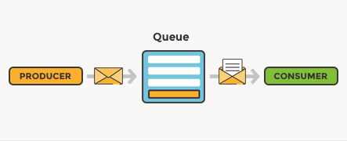
What is message queuing?
Imagine that you have a web service that receives many requests every second, where no request can get lost

Slide 5

Normal message passing:
Producer
Consumer

Slide 6
What if the message gets lost?
Producer
Consumer
Producer
Consumer

Slide 7
?
Producer
Consumer
?

Slide 8

Consumer 1
?
Producer
Consumer 2
Consumer 3

Slide 9

Example by scenario: The creation of whatsapp if done with activemq:

Slide 10
1.Client send requirements to Lead dev
Active MQ:
LeadDeveloper
Client 1
Developer 2
Client 2
Developer 3

Slide 11

2.Lead dev asking something(to elaborate) from separate clients
Active MQ broker:
LeadDeveloper
Client 1
Queue 1
Developer 2
Client 2
Queue 2
Developer 3
Can store messages in queue

Slide 12

3.Lead dev assigning tasks to other developers
Active MQ broker:
LeadDeveloper
Client 1
Queue 1
Developer 2
Client 2
Developer 3
Queue 2
Developer 4

Slide 13

How does ActiveMQ work?

Slide 14
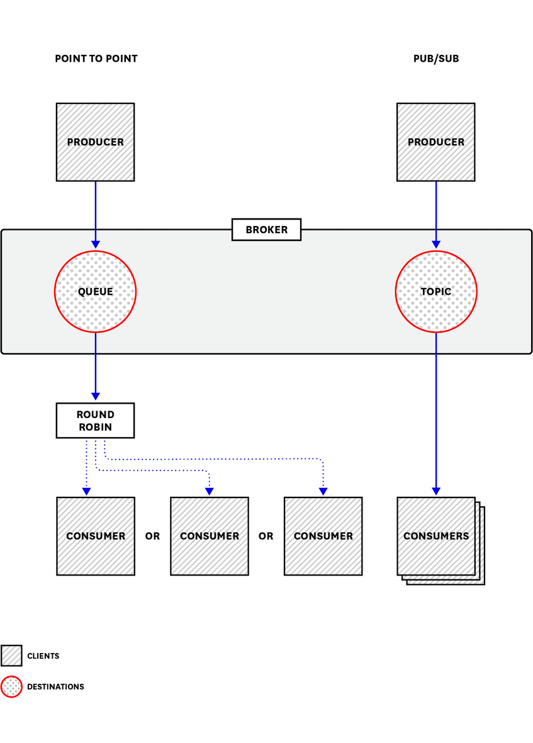
sends messages between client applications—producers, which create messages and submit them for delivery.
consumers receive and process messages.
The ActiveMQ broker routes each message through a queue

Slide 15
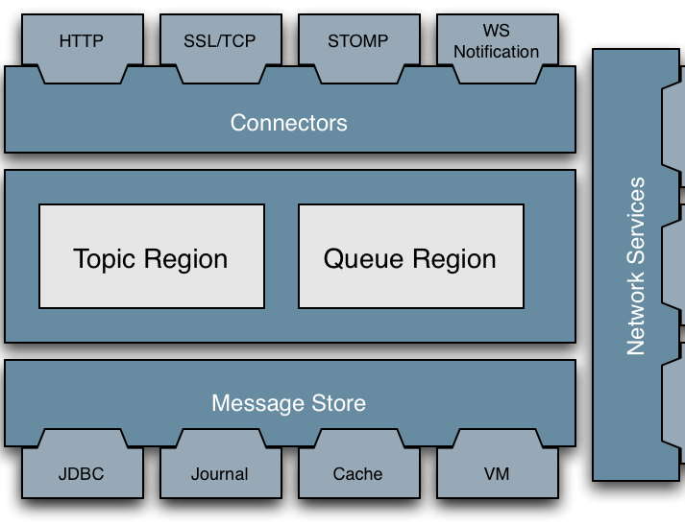
Architecture:

Slide 16
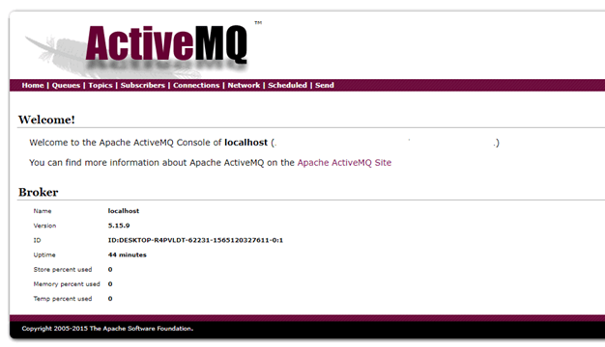
Once you have installed the ActiveMQ server it should be available at http://localhost:8161/admin

Slide 17
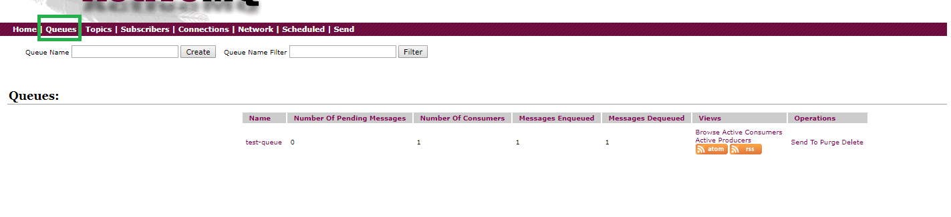
Dashboard stats:

Slide 18
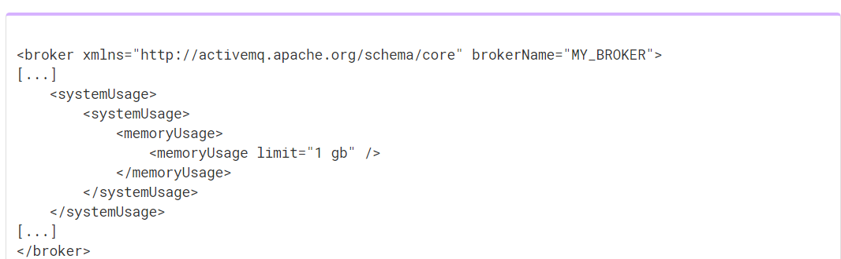
Memory and storage
Each message occupies some of the available memory until it is dequeued.
How much memory depends on the size of the message.

Slide 19
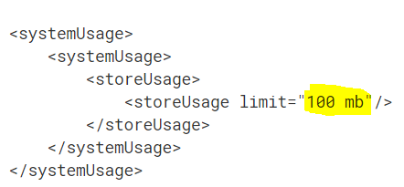

Storage:
KahaDB is ActiveMQ’s default message storage mechanism. It stores both persistent and non-persistent messages.

Slide 20

ActiveMQ metrics:
ActiveMQ metrics is a unique feature which can,
help you proactively maintain your messaging infrastructure
provide you with information you need to investigate,
errors
missing messages
unexpected latency.

Slide 21
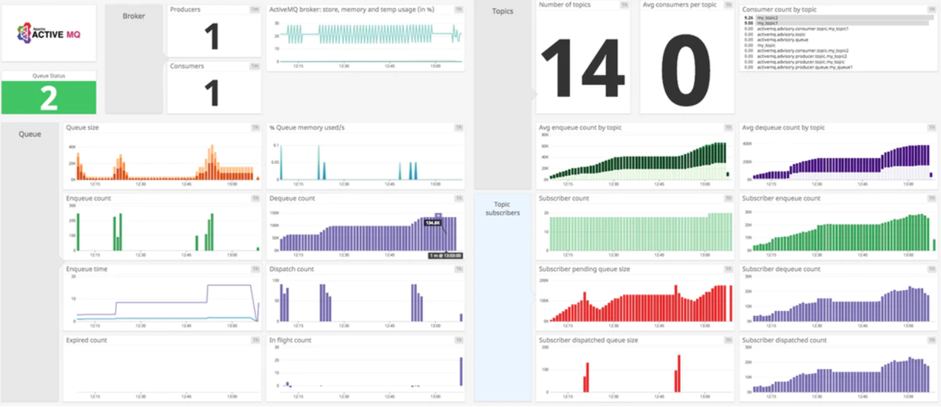

Slide 22


Organizations that use ActiveMQ
Lockheed :
perform COTS integrations
Trimble
to fulfill the need to perform the messaging between and the servers.
Caterpillar:
as a Message broker

Slide 23
Other similar applications to ActiveMQ

Slide 24
Advantages
Open source
Allows applications build with different languages,OS and platforms to integrate with each other.
Location Transparency-Client applications doesnt need to know where the server appliation are located.
Reliable Communications-Both the client and thee server need not to be available at the same time.(due to the queues)
The size of the queueue is dynamic(variable sized queues)

Slide 25
Advantages contd.
Less time consumption-Due to the asynchronous communication,instead waiting till the server sends a response-client can carry con the next set of operations.
Reduced coupling-The information(such as location,protocol and availability) of the service can be changed easily withour effecting the client.
Easy coding.(ActiveMQ uses JAVA where others use Erlang)

Slide 26
Disadvantages:

